Slide 1






Team Mercury
Brent Delbridge, Ian Rose, Sean Wahl,
Grace Cox, Jessica Irving, Hiroaku Matsui,
Anat Shahar, Bill McDonough

Slide 2
Mercury Interior Structure Model
3 layer model, with Si and S in the core
Material properties calculated using Mie- Grüneisen EOS in BURNMAN, with experimental parameters
Adiabatic temperature profile, consistent with icb pressure
Iteratively solves for density, pressure and gravity profiles, with a growing inner core.
Compare to physical parameters (M, C/MR, C_{M}/C).

Slide 3
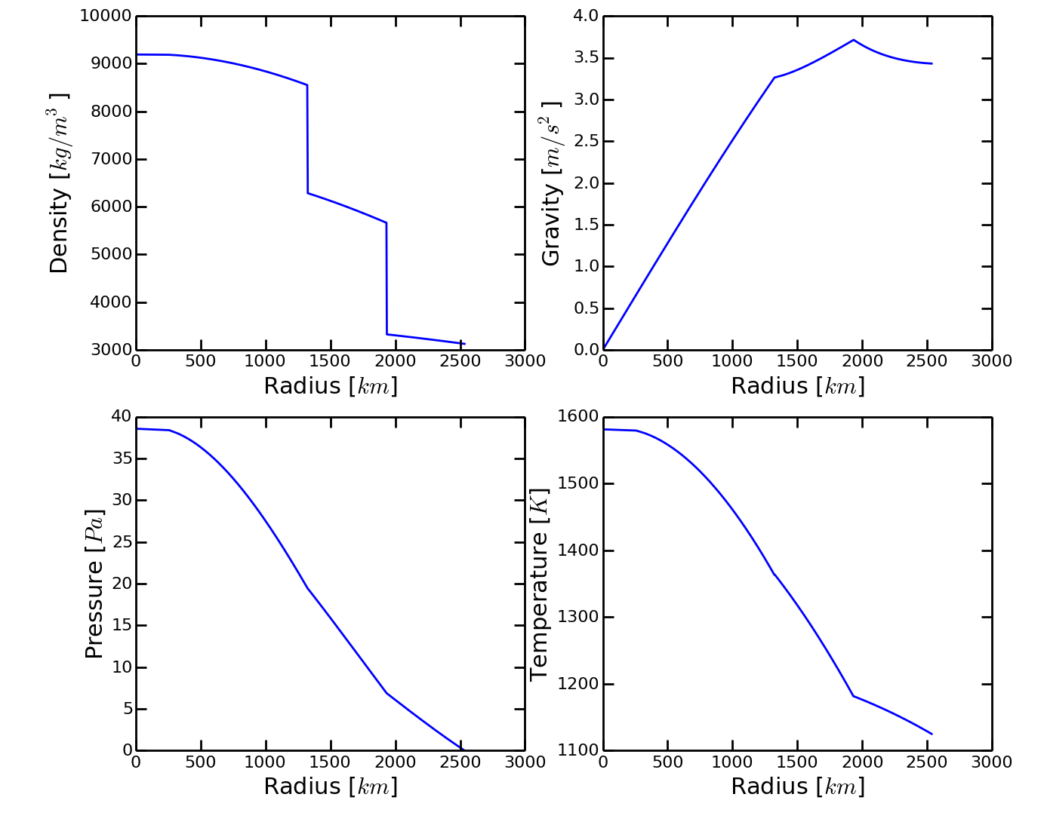
Mercury interior structure model

Slide 4
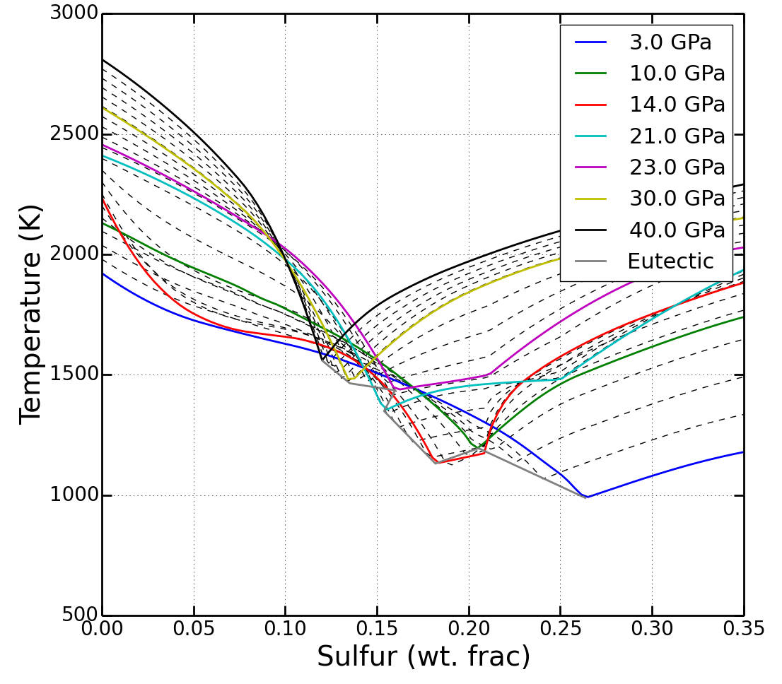
Interpolating liquidus
Spline fits to experimental P-x phase diagrams
Compare to linear interpolation to eutectic
Testing with and without anomalous features

Slide 5
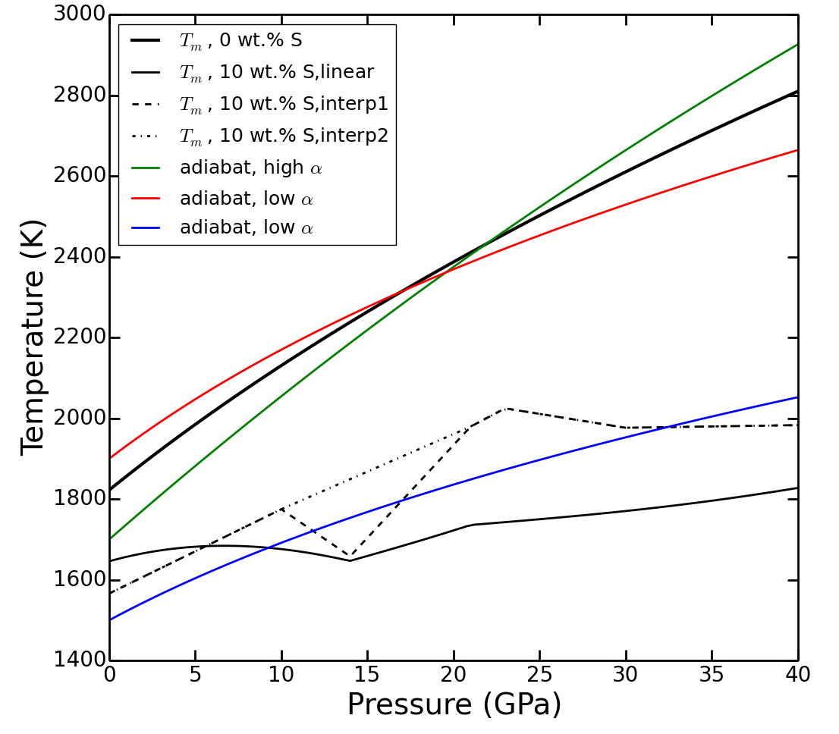
Comparing melting curves and adiabat
Interpolation method has strong effect on pressure dependence of melting
Adiabat steepness has a strong dependence on the thermal expansivity of the liquid

Slide 6
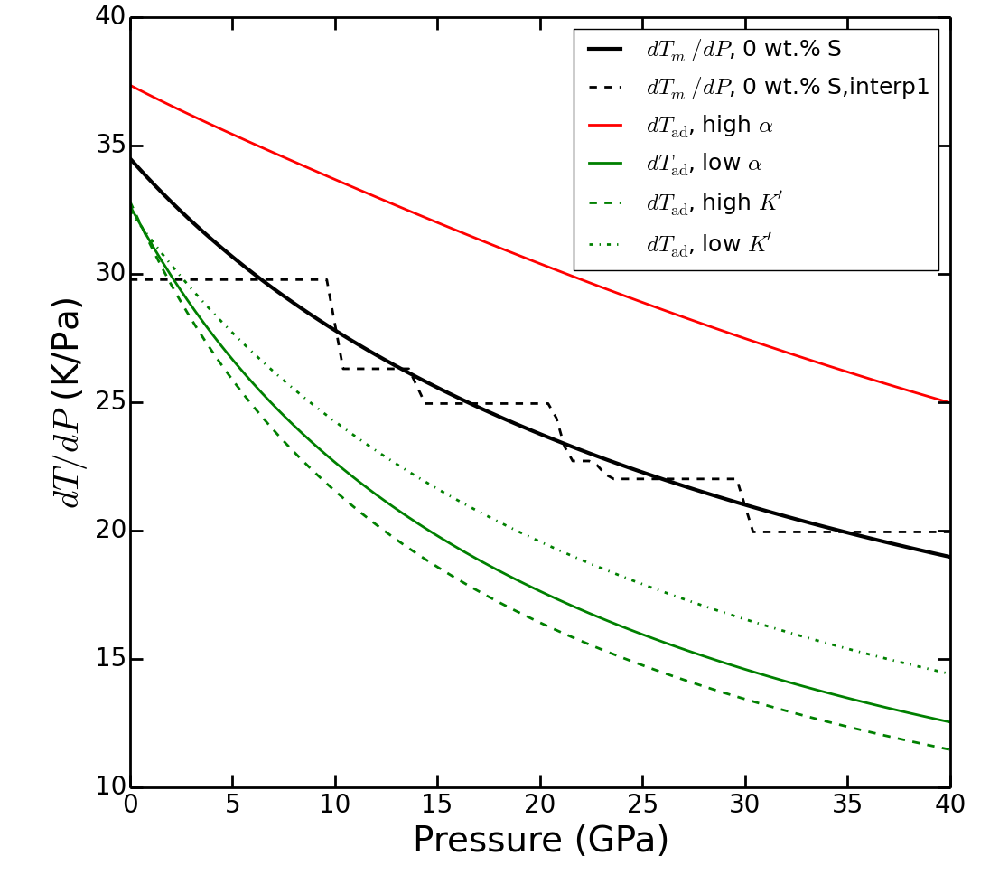
Iron “Snow”?!
Pressure slopes of adiabat and Fe melting curve
Derivative of temperature very sensitive to parameters.
High values for α results in “snow” at all times.
At low values of α, the onset of “snow” layers is strongly dependent on the liquidus model

Slide 7
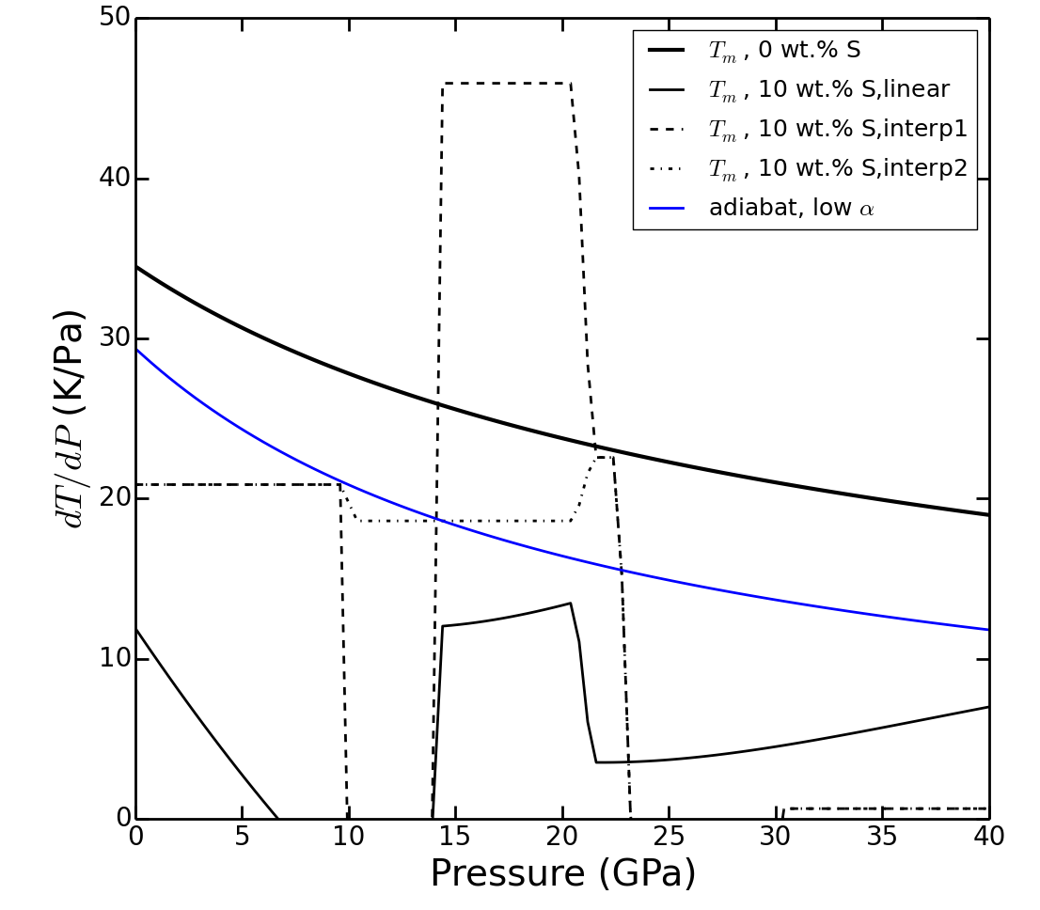
Iron “Snow”?!
Pressure slopes at high S-concentration
Liquidus model effects when and where snowing would occur
All interpolations predict iron snow likely in the 20-40 GPa range.

Slide 8
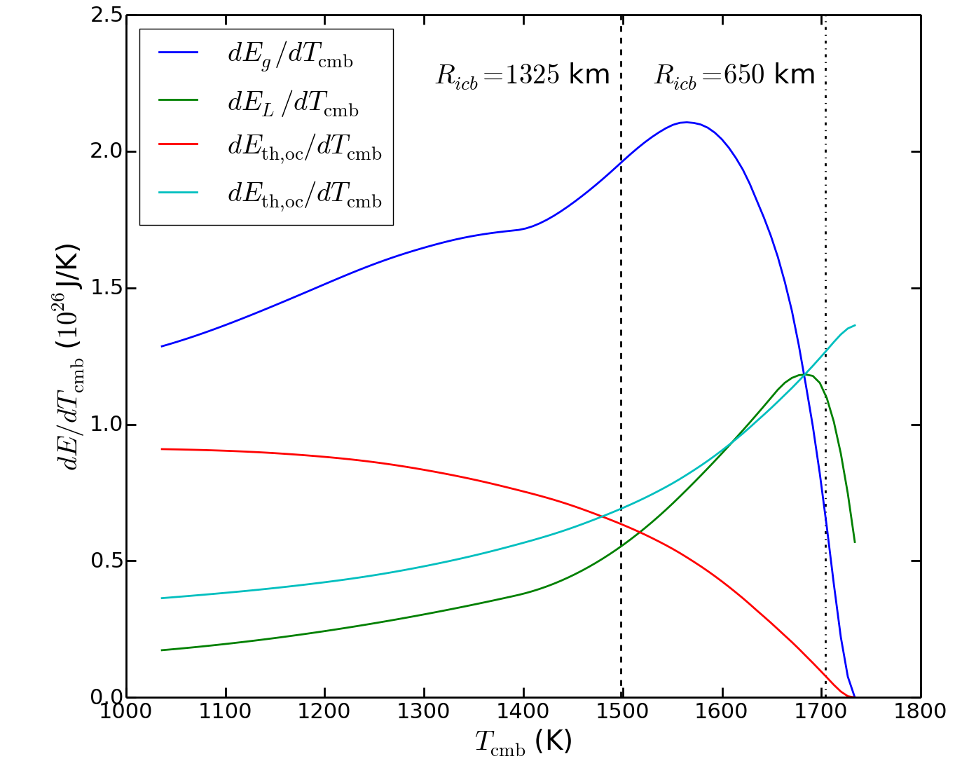
Core Energetics
Determined for a particular bulk core composition and T_{cmb}
Couples interior model to thermal evolution calculations

Slide 9
CMB Heat Flux

Slide 10
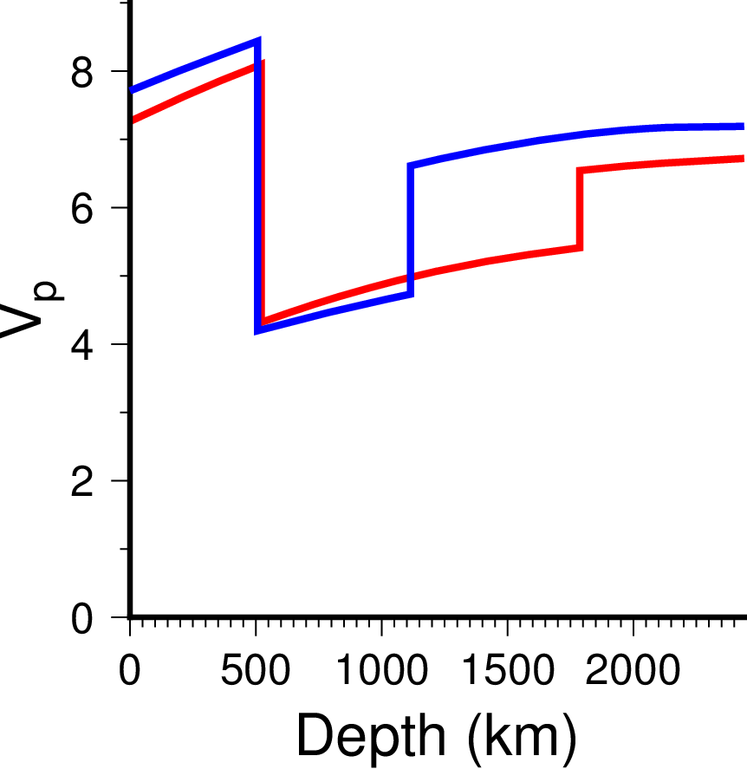
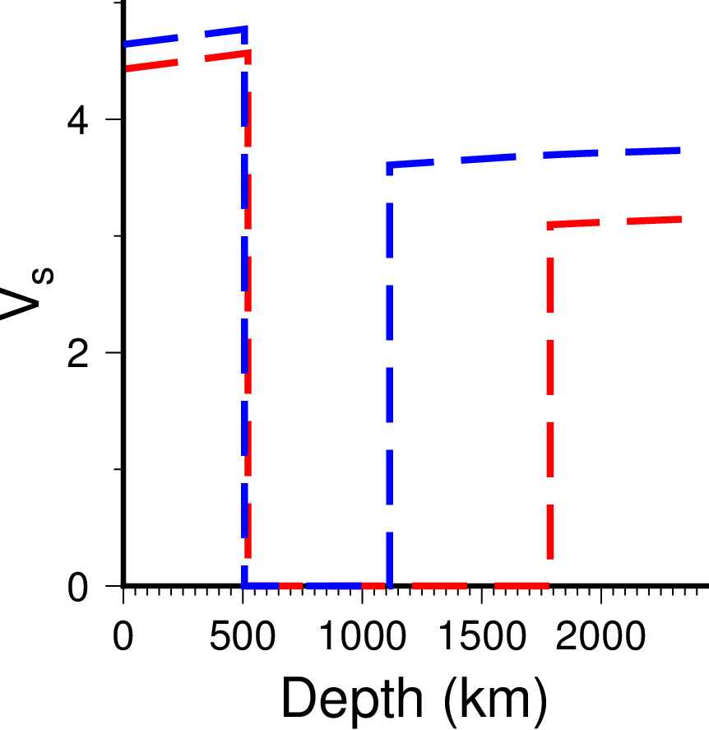
Seismic wave travel times

Slide 11
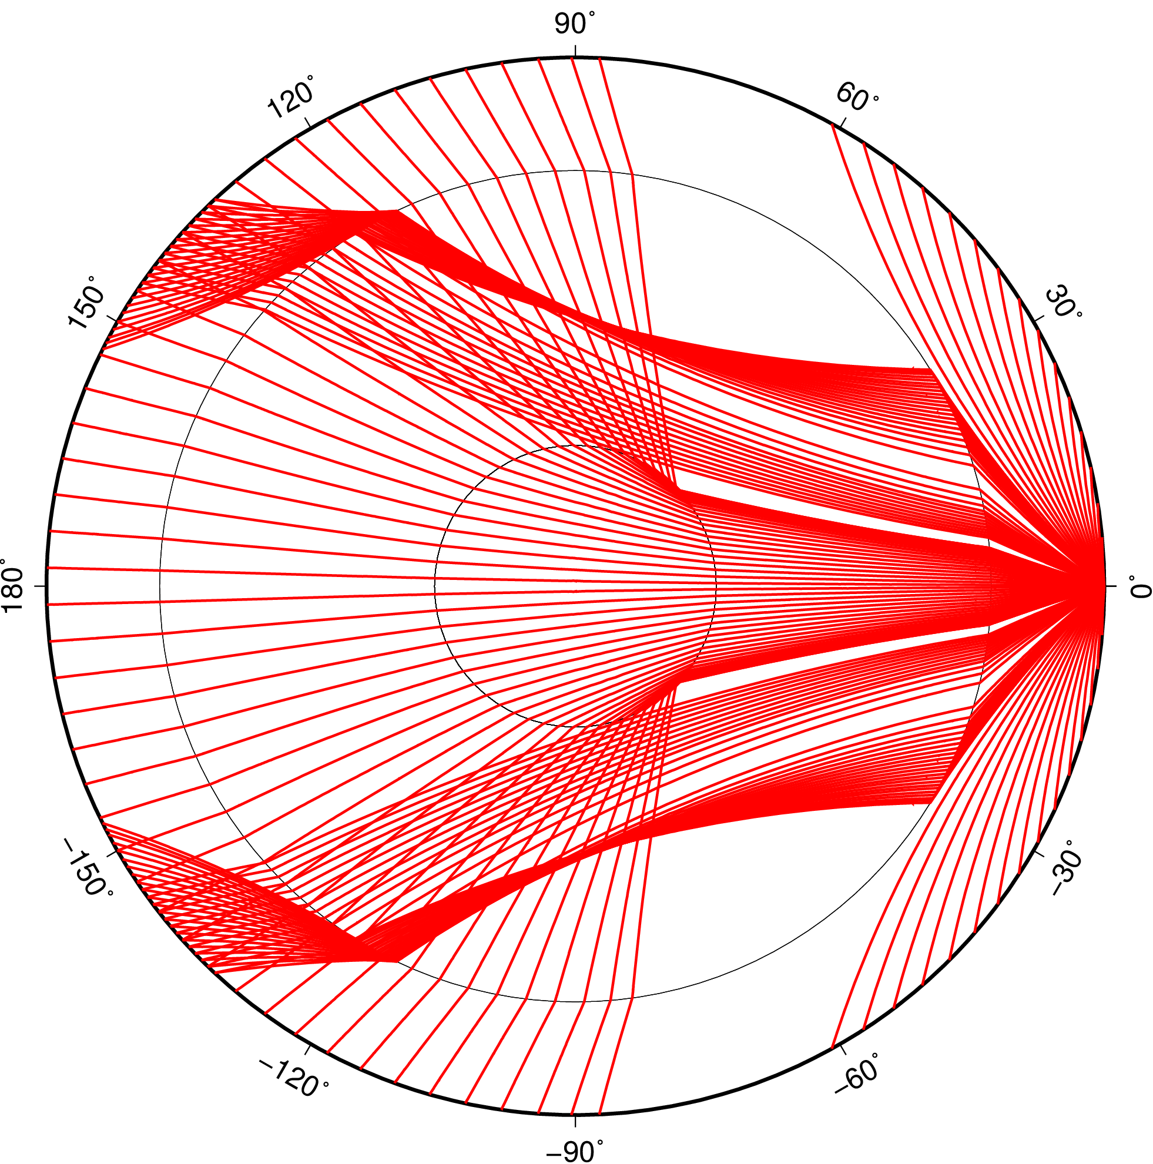
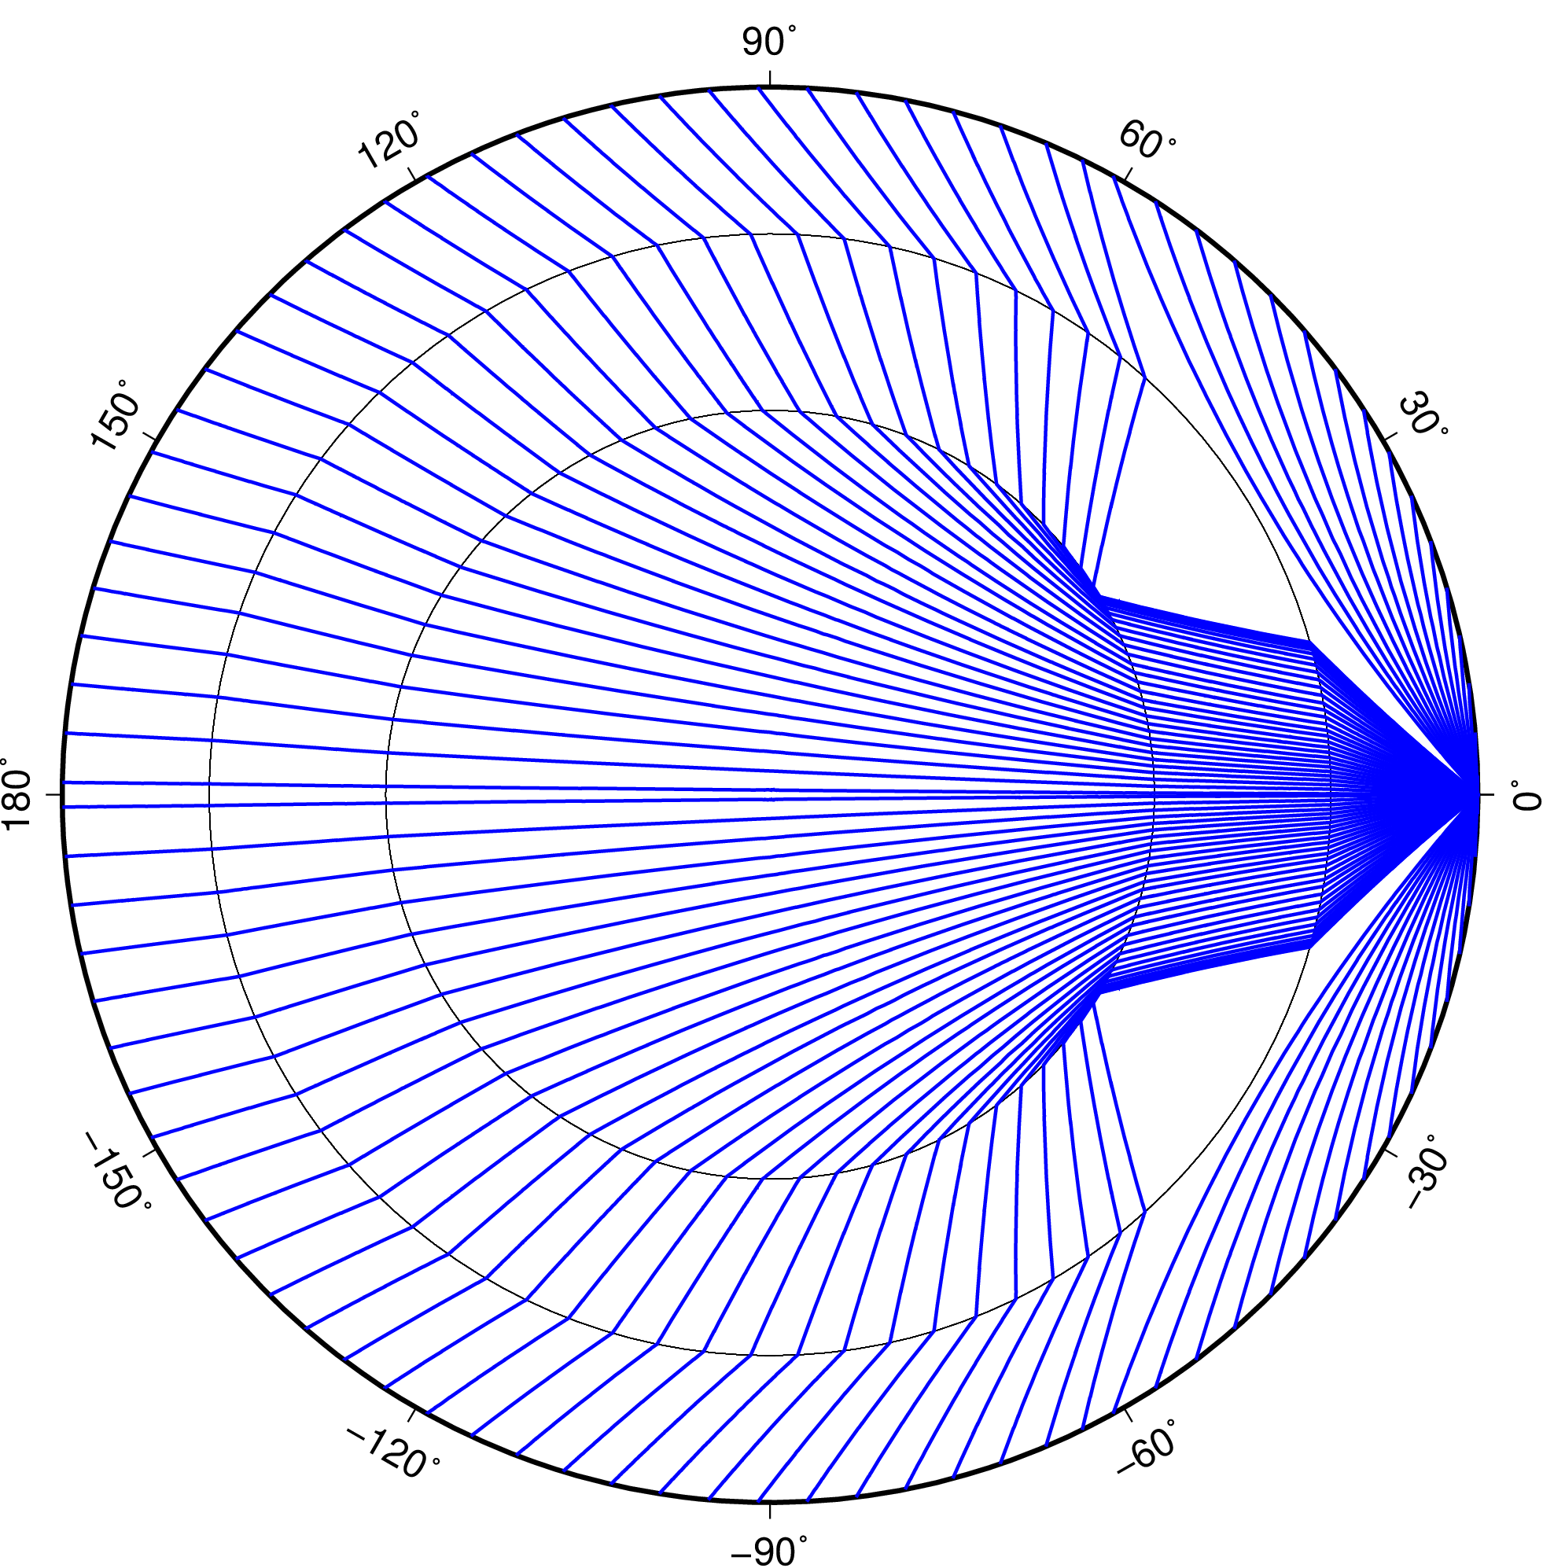
Seismic ray paths

Slide 12
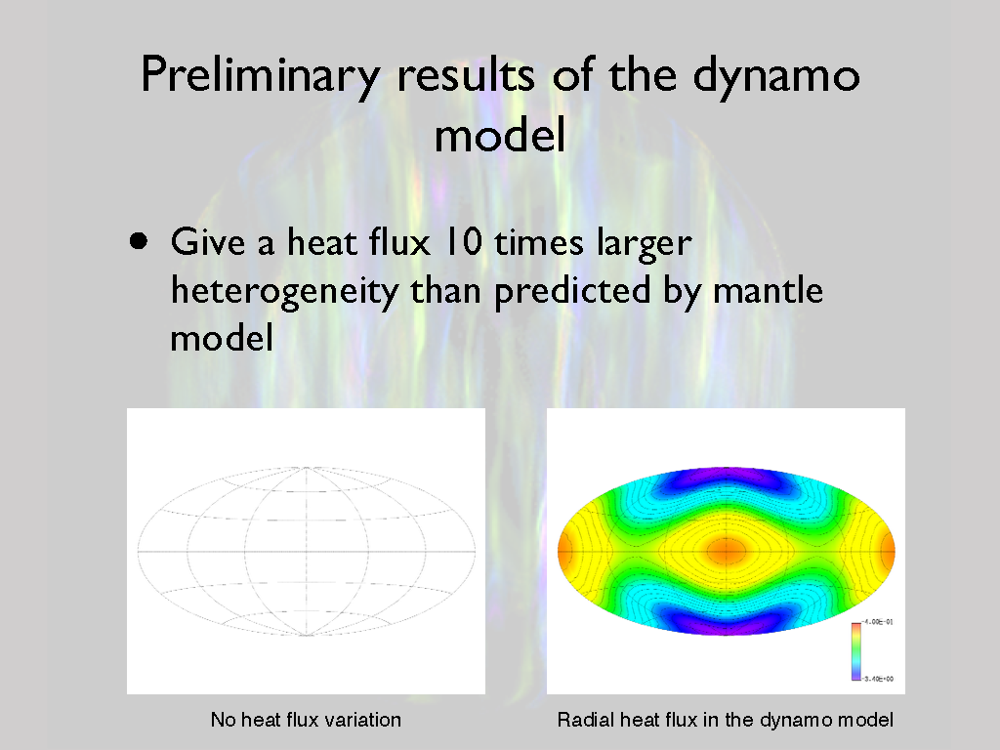

Slide 13
